Slide 1
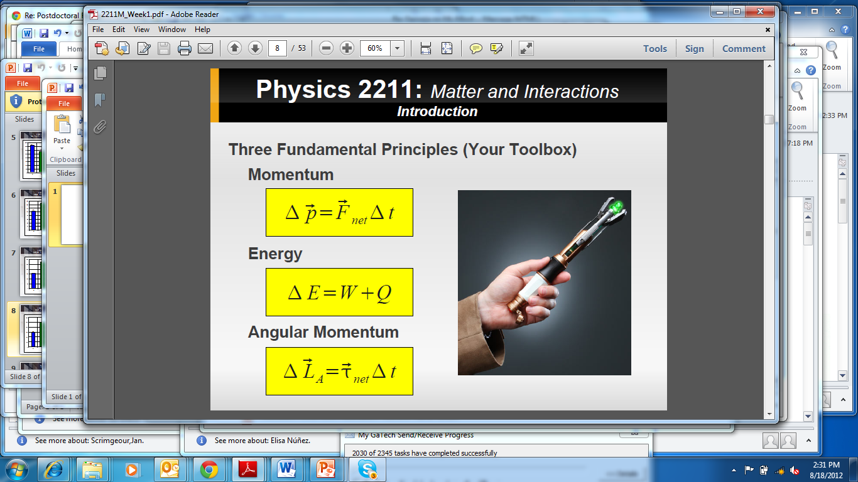
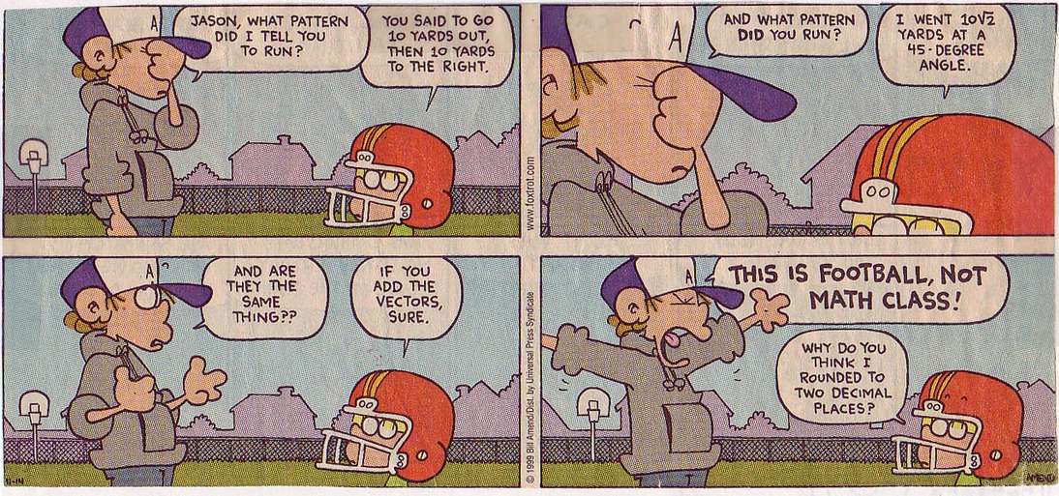
Class II ( scalars and vectors)
Today’s class: Scalars and Vectors

Slide 2
Class II ( scalars and vectors)
Physics 2211, Section M.
Mondays, Wednesdays, and Fridays.
10:10-11:00 am
Professor: Flavio H. Fenton
E-mail: Flavio.Fenton@physics.gatech.edu
Please include: Phys221C
at the beginning of the subject
Office Hours: TBD Howey C203

Slide 3
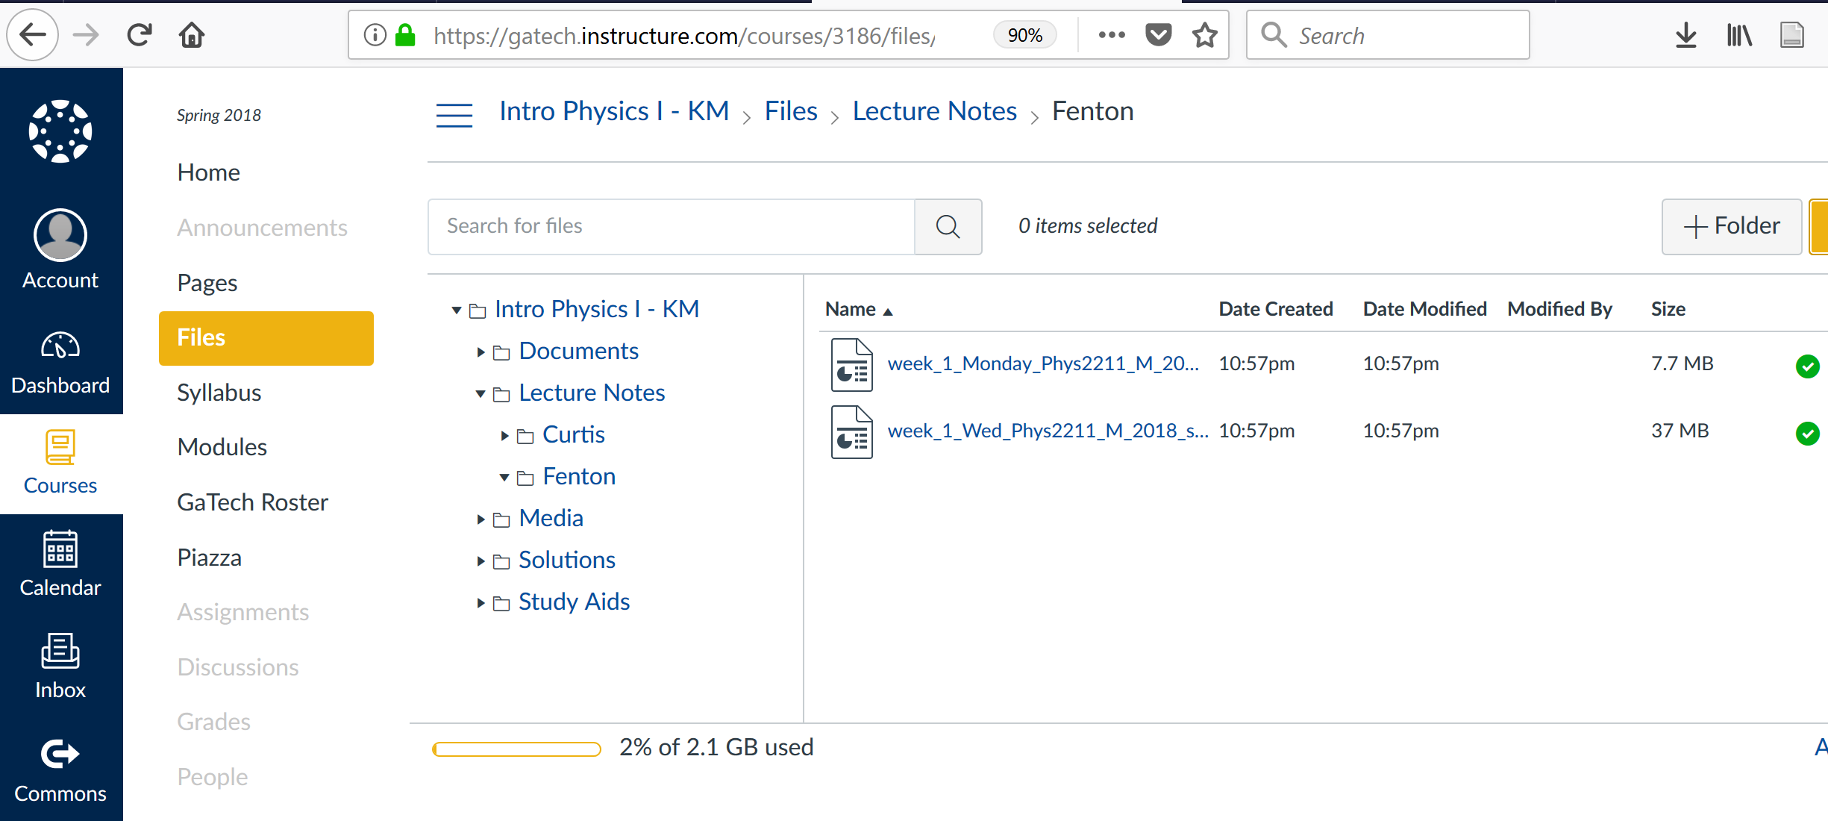
Class II ( scalars and vectors)
Slides from the class every day posted after class:

Slide 4
Class II ( scalars and vectors)
Todays objective:
Vectors and Scalars:
our first tools to help us describe the world
(systems) and their interactions

Slide 5
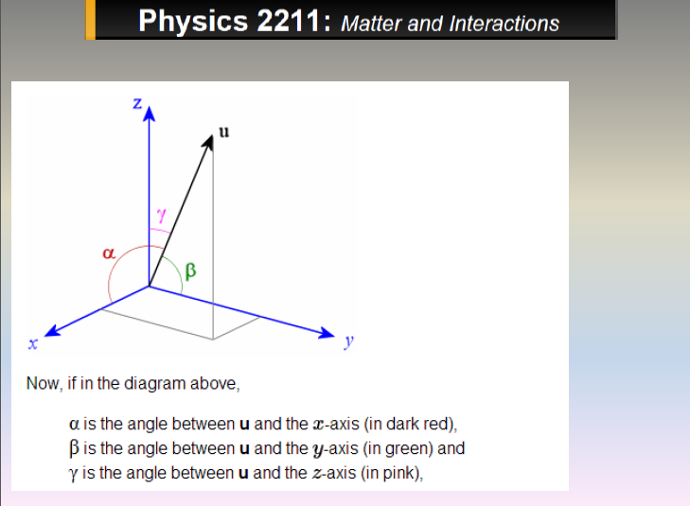
Class II ( scalars and vectors)
Fun with vectors
Definitions:
Scalars
Vectors

Slide 6
Class II ( scalars and vectors)
Fun with vectors
Definitions:
Quantities that can be entirely described in terms of a magnitude (amount)
Scalars:
Don’t depend on changes in orientation
Quantities that indicate a magnitude and an orientation.
Vectors:
They also depend on an origen

Slide 7
Class II ( scalars and vectors)
Fun with vectors
Definitions (Some examples):
Distance, speed, mass, temperature, charge, density, electric potential, area, volume, energy, angle, etc.
Scalars:
Position, velocity, acceleration, force, ECG, gravitational field, electric field, magnetic field, etc.
Vectors:

Slide 8
Class II ( scalars and vectors)
Vectors: Quantities that have both magnitude and direction.
Represented by an arrow
B (terminal point)
v, v, or AB
A (initial point)

Slide 9
Class II ( scalars and vectors)
If two vectors, u and v, have the same:
magnitude (length) and
direction (angle)
We say they are equivalent
v
u

Slide 10
Class II ( scalars and vectors)
If two vectors, u and v, have the same:
magnitude (length) and
direction (angle)
We say they are equivalent
u
= v
≠ w
w
≠ r
v
u
r

Slide 11
Class II ( scalars and vectors)
The magnitude and direction of a vector needs to be given in reference to something .
Need to define an origin
Need to define a coordinate system
w
v
u
r

Slide 12
Class II ( scalars and vectors)
The magnitude and direction of a vector needs to be given in reference to something .
Need to define an origin
Need to define a coordinate system
y
in 2D:
v
v
x

Slide 13
Class II ( scalars and vectors)
The magnitude and direction of a vector needs to be given in reference to something .
Need to define an origin
Need to define a coordinate system
y
y
In 2D:
v=< a , b > = <v_{x} , v_{y}>
v
v
v
v
b = v_{y}
x
x
a = v_{x}

Slide 14
Class II ( scalars and vectors)
The magnitude and direction of a vector needs to be given in reference to something .
Need to define an origin
Need to define a coordinate system
y
In 2D:
y
In 3D:
a = v_{x}
(a,b,c)
v
v
c
b = v_{y}
a
x
x
b
v=< a , b > = <v_{x} , v_{y}>
z
v=<a,b,c> = <v_{x},v_{y},v_{z}>

Slide 15
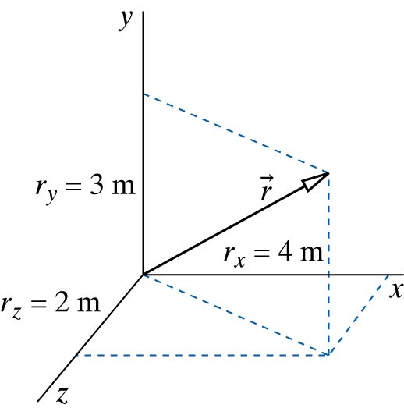
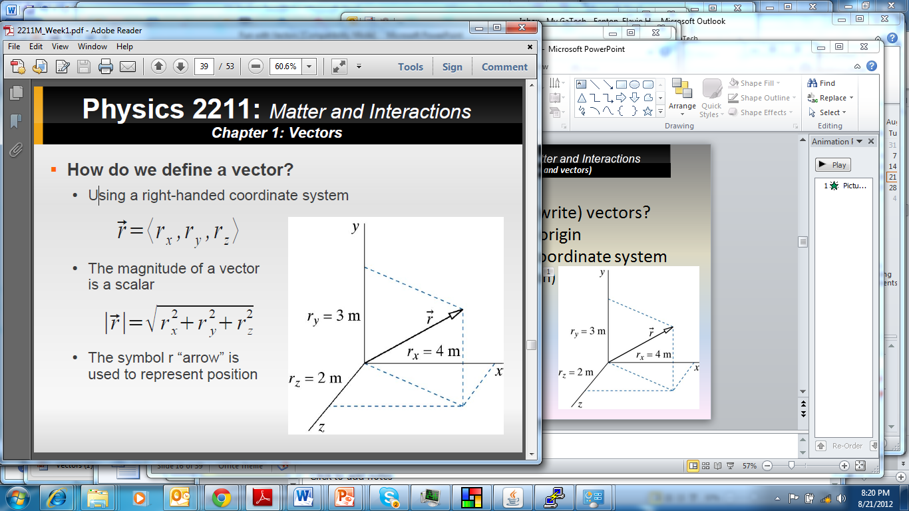
Class II ( scalars and vectors)
The magnitude and direction of a vector needs to be given in reference to something .
Need to define an origin
Need to define a coordinate system
(Right-handed convention)
How do we calculate the
magnitude of a Vector?

Slide 16
Class II ( scalars and vectors)
The magnitude and direction of a vector needs to be given in reference to something .
Need to define an origin
Need to define a coordinate system
(Right-handed convention)
Remember a = vector
|a | = scalar (magnitude) of a vector

Slide 17
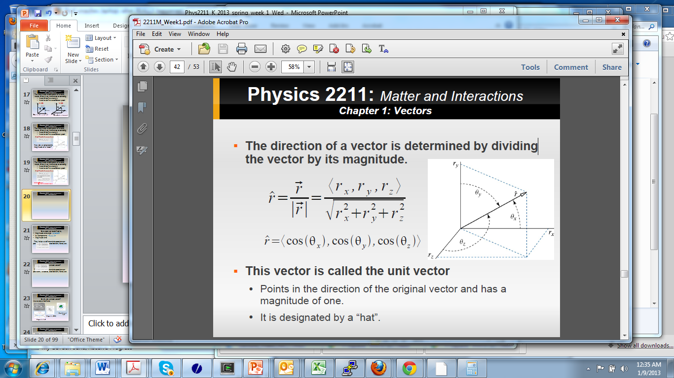
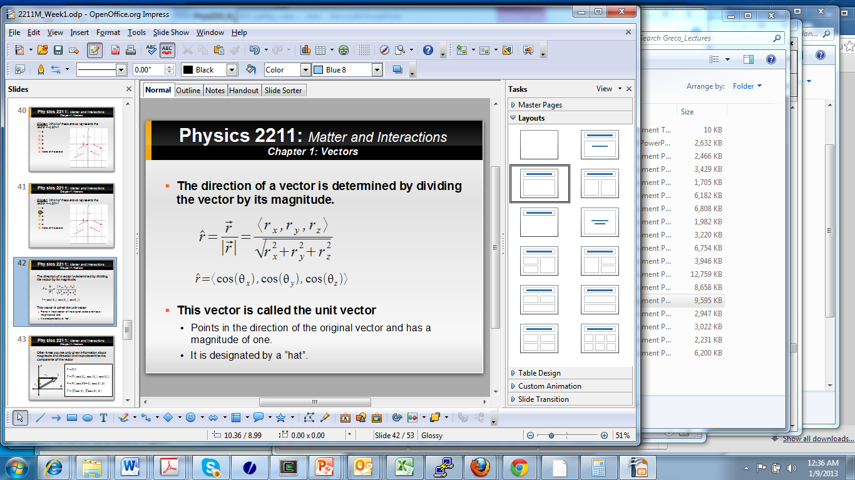
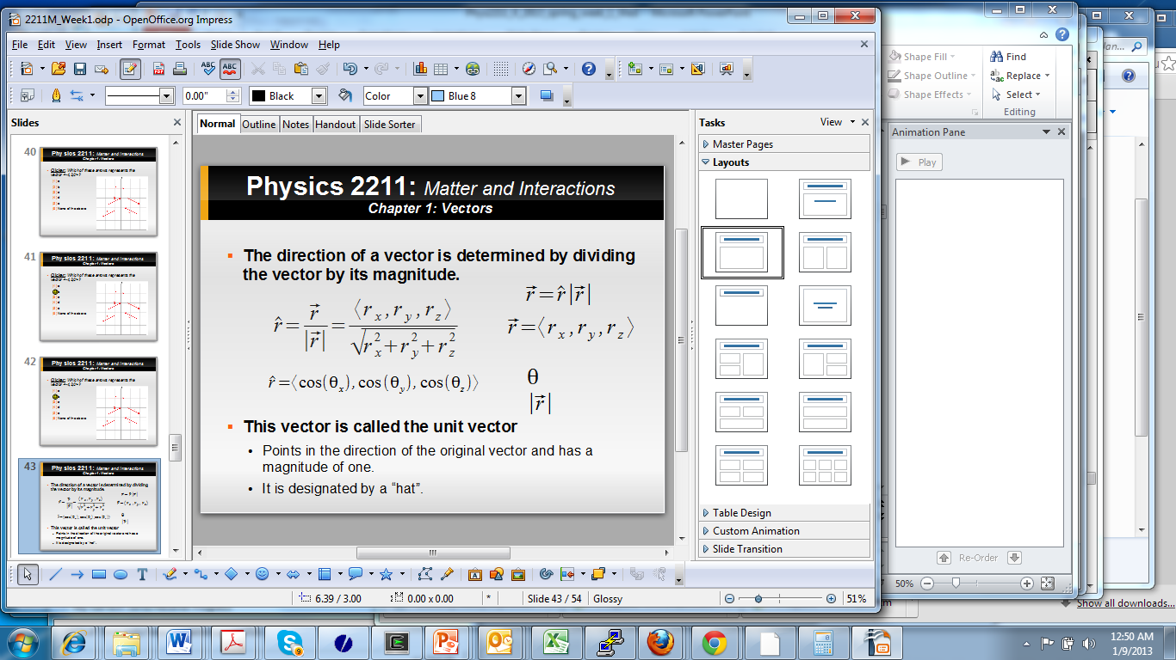
Class II ( scalars and vectors)
Any Vector can be written
As it’s magnitude times
it’s unitary vector

Slide 18
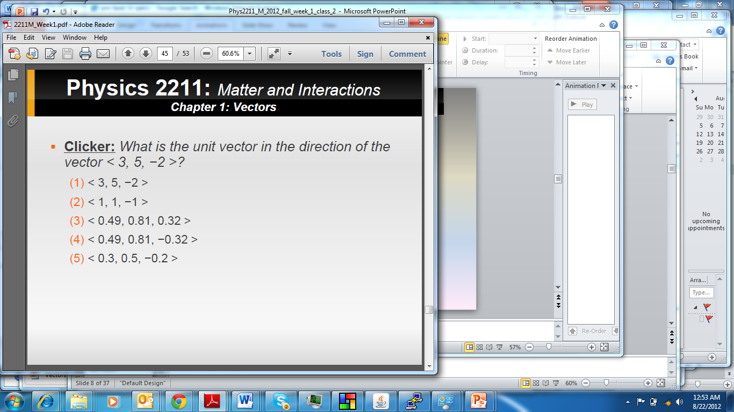
Class II ( scalars and vectors)
Can the magnitude of a vector be negative?

Slide 19
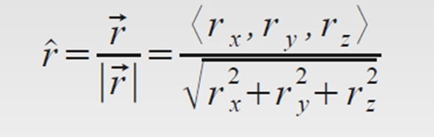
Class II ( scalars and vectors)
Remember:
Can the magnitude of a vector be negative?

Slide 20

Class II ( scalars and vectors)
Remember:
Can the magnitude of a vector be negative?
What is the magnitude of a unit vector?

Slide 21
Class II ( scalars and vectors)
So why do we need vectors?
They helps us define and do operations on positions, velocities, accelerations, forces, etc.

Slide 22
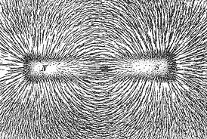
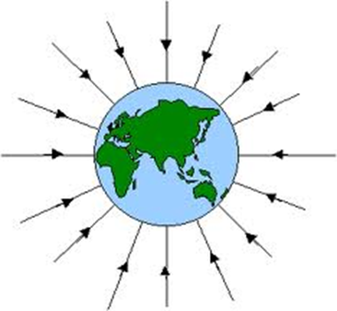
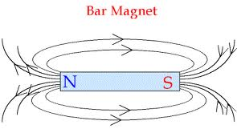
Class II ( scalars and vectors)
So why do we need vectors?
Also to describe fields
Gravitational
field
Magnetic (ECG)
Magnetic field

Slide 23
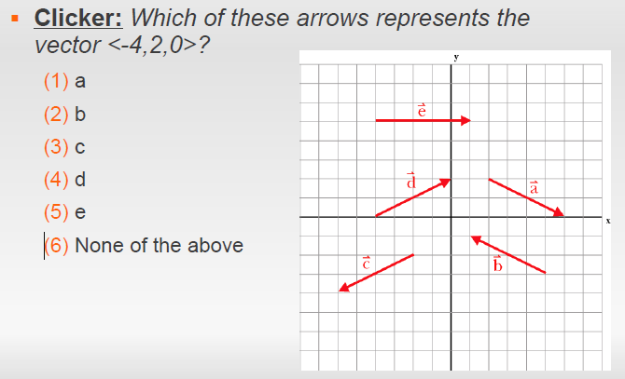
Class II ( scalars and vectors)

Slide 24
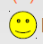
Class II ( scalars and vectors)

Slide 25
Class II ( scalars and vectors)
In many problems we may not have the components, or do not have a square grid

Slide 26
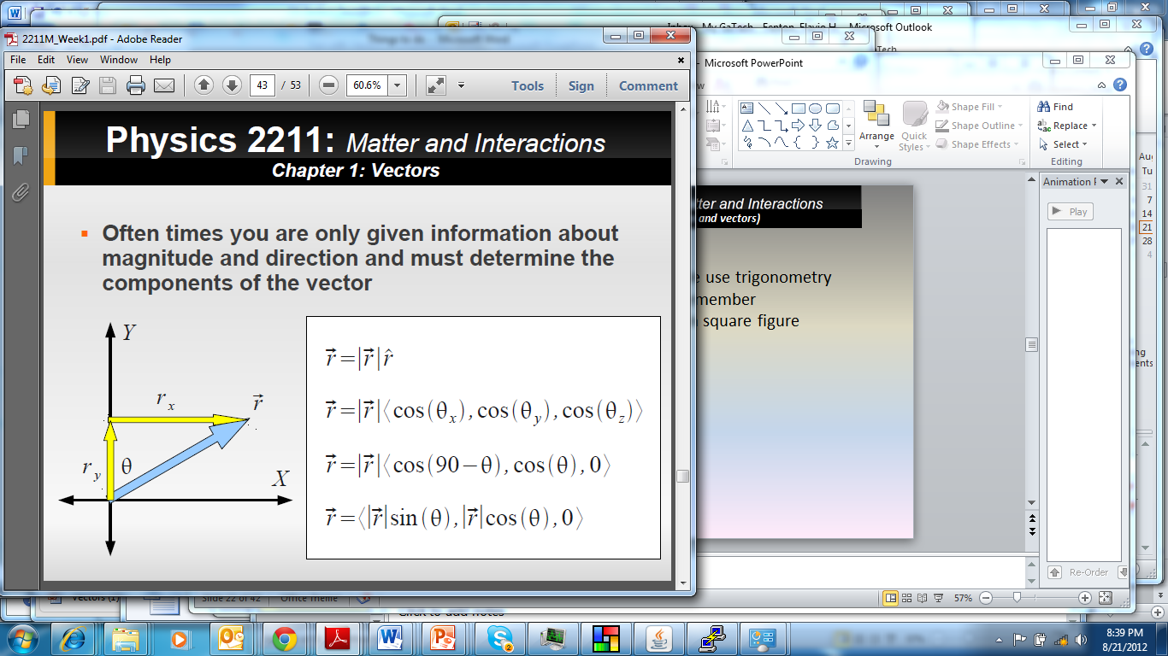
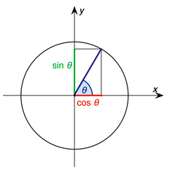
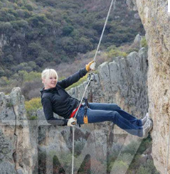
Class II ( scalars and vectors)
In such case we use trigonometry,
Remember the unit circle for 2D
Sin²θ + Cos²θ = 1

Slide 27
Class II ( scalars and vectors)
y
y
In 2D:
In such case we use trigonometry,
Remember the unit circle for 2D
Sin²θ + Cos²θ = 1
v
v
b = v_{y}
θ
x
a = v_{x}
x
|V| = 5 and θ = 40⁰
a = 5*Cos(40) b=5*Sin(40)
Also:
a = 5*Sin(90-40) b=5*Cos(90-40)

Slide 28
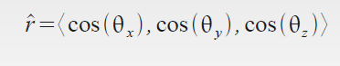
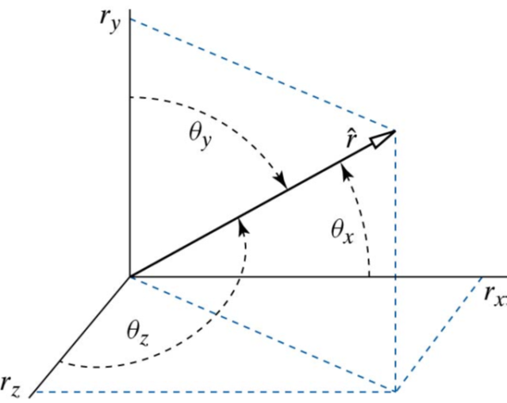
Class II ( scalars and vectors)
In 3D:
In such case we use trigonometry,
Remember the unit circle for 2D
Sin²θ + Cos²θ = 1

Slide 29
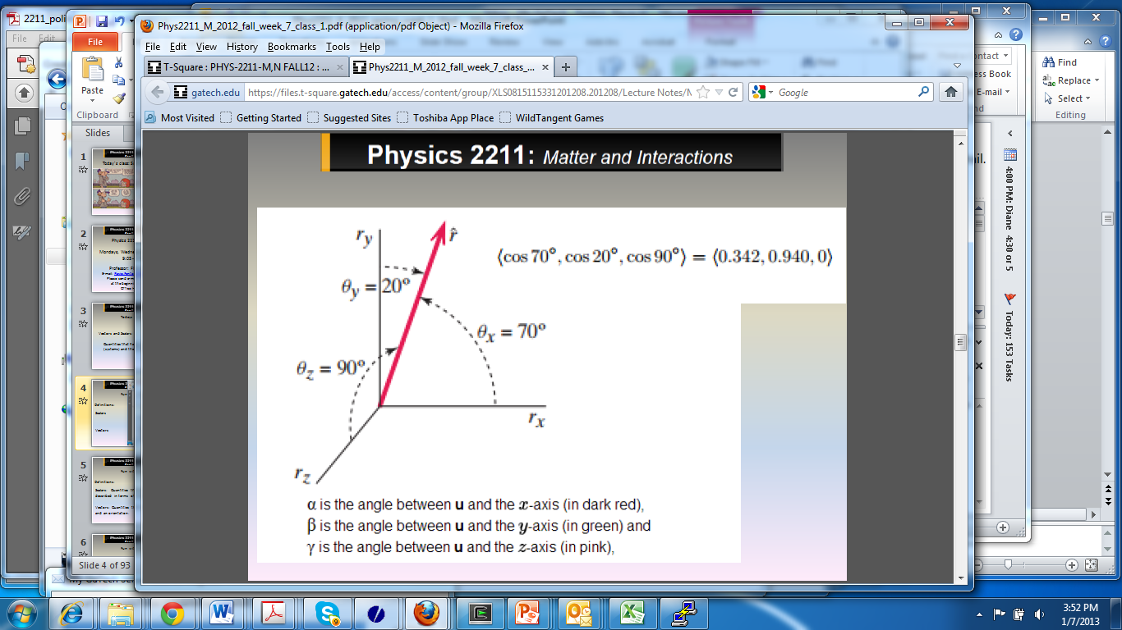
Class II ( scalars and vectors)
In 3D:

Slide 30
Class II ( scalars and vectors)
So a vector can be defined by
Magnitude and angle
Its components
Magnitude and unit vector

Slide 31
Class II ( scalars and vectors)
Vectors: Two ways of describe vectors by components or by magnitude and angles with respect to the coordinate systems:
In 2D one angle is sufficient
In 3D two angles are sufficient
v
All the following describe the same vector:
Magnitude of 5 and angle 30⁰
|V|=5, θ=30⁰
5 <cos(30), sin(30)> = 5< 0.866,0.5> = < 4.33,2.5>
We can check magnitude: sqrt( 4.33² + 2.5²) = 5
We can check angle: θ= arctan (v_{y}/v_{x}) = 30
What if we use the cosines?
5 <cos(30), cos(60)> = < 4.33,2.5>

Slide 32
Class II ( scalars and vectors)
As we talked before, often there are more
than one way to solve a problem

Slide 33
F
F =|F|< cos θ, sin θ >
=|F|< sin φ, cos φ >
=|F|<cos θ, cos φ >
=|F|<cos θ, cos 90- θ>
φ
θ
G
G =|G|< -sinϒ, cos ϒ >
=|G|< -cos ρ, sin ρ >
=|G|<cos(90+ϒ),cos ϒ>
=|G|<cos(180- ρ),cos(90- ρ)>
=|G|<cos(180-ρ),cos(ϒ)>
ϒ
ρ
sin
cos

Slide 34
Homework
Try it at home
(use a value for the angles
to convince yourself)
θ
φ
F
ρ
G
ϒ
sin
cos

Slide 35
Class II ( scalars and vectors)
Bees and Vectors
Bees know about vectors and use them to indicate pollen sources to others in the colony.

Slide 36
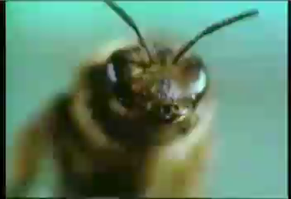
Class II ( scalars and vectors)
Bees and Vectors
Bees know about vectors and use them to indicate pollen sources to others in the colony.

Slide 37
Class II ( scalars and vectors)
Operations with vectors (new algebra):
Multiplication of a vector with a scalar.
Division of a vector with a scalar.
Addition of two vectors.
Subtraction of two vectors.
Calculating the magnitude of a vector
Calculating the rate of change of a vector
Multiplications of vectors (two types, dot and cross product). These two will be study later in the semester.

Slide 38
Class II ( scalars and vectors)
Operations NOT possible with vectors:
Vector equal to a scalar.
Vector can not be added/subtracted to a scalar.
Division by a vector (but you can divide by the magnitude of a vector).

Slide 39
Class II ( scalars and vectors)
Operations with vectors (new algebra):
Multiplication (division) of a scalar and a vector
a

Slide 40
Class II ( scalars and vectors)
Operations with vectors (new algebra):
Multiplication (division) of a scalar and a vector
2a
a
a
-½ a
-a

Slide 41
Class II ( scalars and vectors)
Operations with vectors (new algebra):
Addition of vectors (Graphically)
b
a

Slide 42
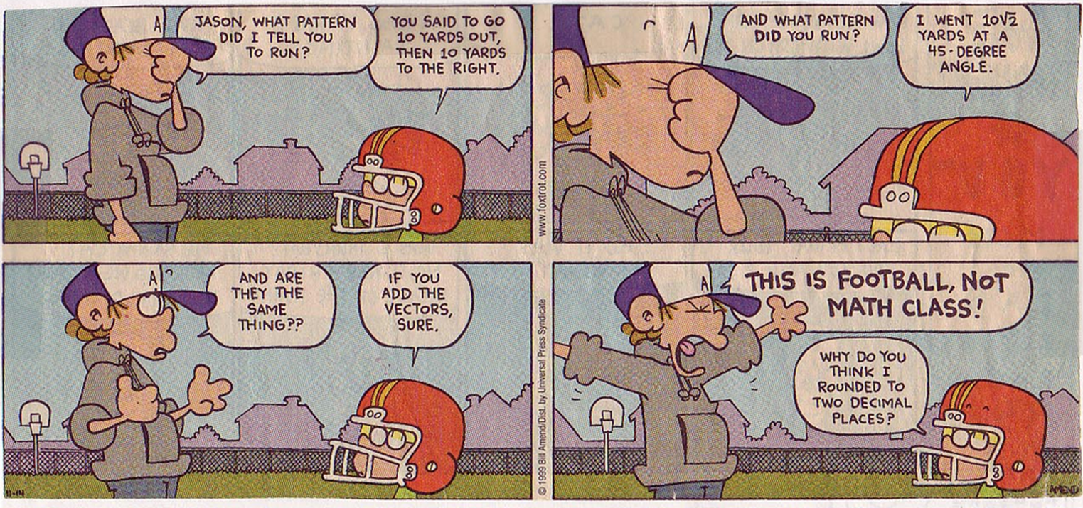
Class II ( scalars and vectors)
Operations with vectors (new algebra):
Graphical rule for additions:
1. Connect one vector after another (tip to tail)
2. The resulting vector is obtained by drawing from the beginning of the first vector to the end of the second.
b
a

Slide 43
Class II ( scalars and vectors)
Operations with vectors (new algebra):
Graphical rule for additions:
1. Connect one vector after another (tip to tail)
2. The resulting vector is obtained by drawing from the beginning of the first vector to the end of the second.
Note:
Same result
For a+b and b+a
b
a+b
a
a+b
a
b

Slide 44
Class II ( scalars and vectors)
Operations with vectors (new algebra):
Graphical rule for subtractions:
Connect the two vectors by their starting points (tail to tail)
The resulting vector is obtained by drawing from the end of the negative vector to the end of the positive vector
b-a
a-b
b
a
b
a
Note the change in direction!!

Slide 45
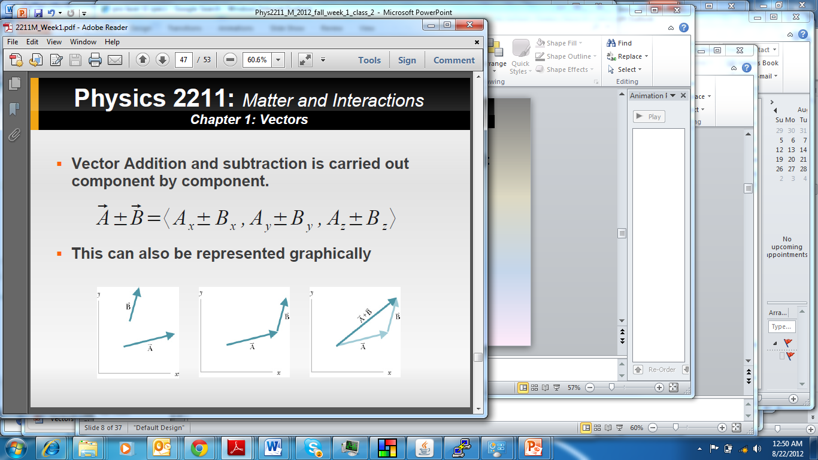
Class II ( scalars and vectors)
Operations with vectors (new algebra):
Addition/subtraction of vectors analytically
a-b
b
a+b
b
a
a

Slide 46
Class II ( scalars and vectors)
Operations with vectors (new algebra):
Analytical rule for additions and subtractions:

Slide 47
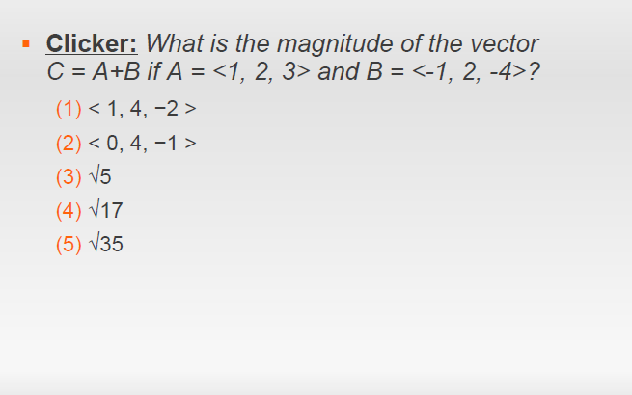
Class II ( scalars and vectors)

Slide 48
Class II ( scalars and vectors)

Slide 49
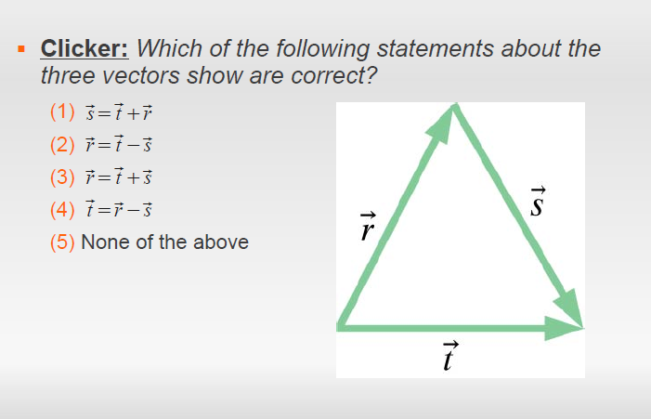
Class II ( scalars and vectors)

Slide 50
Class II ( scalars and vectors)

Slide 51
Class II ( scalars and vectors)
Summary questions:
How many numbers needed to specify a 3D vector?
How many numbers needed to specify a scalar?

Slide 52
Class II ( scalars and vectors)
Summary questions:
Can the magnitude of a vector be negative?
Answer: No, it is always positive.
Are all the components of a unit vector always less than one?
Is vector addition commutative?
Answer: yes
Is vector subtraction commutative?
Answer: No
Answer: yes.

Slide 53
Class II ( scalars and vectors)
Operations with vectors (new algebra):
Subtraction of vectors (Graphically)
b
a

Slide 54
Class II ( scalars and vectors)
Operations with vectors (new algebra):
Subtraction of vectors (Graphically)
b
-b
a-b
a

Slide 55
Class II ( scalars and vectors)
Operations with vectors (new algebra):
Subtraction of vectors (Graphically)
b
What about b-a?
-b
a-b
a

Slide 56
Class II ( scalars and vectors)
Operations with vectors (new algebra):
Addition of vectors (Graphically)
b
a
a+b
b+a
b
a

Slide 57
Class II ( scalars and vectors)
Operations with vectors (new algebra):
Addition of vectors (Graphically)
b
a
a+b
-a
b
a
b-a

Slide 58
Class II ( scalars and vectors)
Operations with vectors (new algebra):
Addition of vectors (Graphically)
b-a
b
a
a+b
-a
b
-a
a
b-a

Slide 59
Class II ( scalars and vectors)
Operations with vectors (new algebra):
Addition of vectors (Graphically)
b-a
b
a
-b
-a
a-b
a

